Slide 1
BigData for Bing Ads

Slide 2
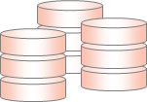


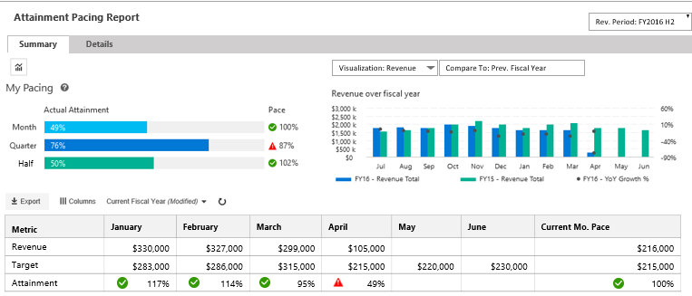
Architecture
Architecture Overview of UCM-B
SOURCES/
PRODUCERS
COLLECTION / STAGING
MERGE/CLEANSING
/ENRICHMENT
TRANSFORMATION
BUSINESS RULES
CACHED VIEWS
PIVOTS
PRESENTATION/
ACTIONS
Azure Data Factory
[ Data Ingestion, Layers Orchestration and Data Auditing]
Staging Area Subscriber
[Accounts, Customer, Exchange rates, etc.]
ETL
Adhoc Engines
Azure Data Lake
ADW
MDX CUBE
KPIs, Metrics Hierarchy
ADLS STAGING
WARM
Business
Users
Confirmed Dimensions
Date, Product, etc.
Optimized for 2 year
SQL Sources
PAAS: UCM
On-Premise : MDB
SQL Server Gateway
USQL
ADLS STAGING
WARM
Dimensions
Customer, Account, ..
Delta Merges
Business Reporting Views
UCM-B Business Reporting Web site
Analysis Services
RvR Cube
PowerShell Upload
Facts
Revenue, Attainments,
Relational DW
Account Teams
ADLS as TSV
[Archived daily]
Maps
Account-CU, Timeline
Cached Data
WWIC Flat Files
Structured Files
[KPIBillingCube]
WWIC Views
COLD
USQL
HYBRID PROCESSING
WWIC Teams
HYBRID STORAGE [BLOB/DB]
NORMALIZE
METRICS ENGINE
REPORTING and UIX

Slide 3

Data Flows & Pipelines
Data sources & Pipelines in UCM-B
SOURCES/
PRODUCERS
STAGING
ADLS
CLEANSING
/ENRICHMENT
TRANSFORMATION
ADLA / USQL
RDBMS
ADW
CACHED
VIEWS
PIVOTS
Cube
PRESENTATION/
ACTIONS
Accounts
Customer
Exchange
Staging Area Subscriber
FULL FILE
MERGING
CATALOG
TABLE(S)
1
ATTAINMENTS
--------------------
CLIENT UNIT
SEGMENT
NEW BUSINESS
CHANNEL PARTNER
MDX Cube
Timeline
MDB
FULL FILE
MERGING
CATALOG
TABLE(S)
2
Assignments
Quotas
Teams
UCM
FULL FILE
MERGING
CATALOG
TABLE(S)
3
6
Gross, Net, Billed
RvR
WWIC VIEWS
WWIC Hand off DB
[FUTURE]
WWIC Flat Files
FULL DATA
DEGENERATION
CATALOG
TABLE(S)
4
8
Revenue
REVENUERECSUMMARY
INCR FILE
DEGENERATION
CATALOG
TABLE(S)
UCM BUSINESS REPORTING
5
BUSINESS REPORTING
7

Slide 4
Data Flows & Pipelines
Program Overview
1
UCM-B Staging Area Subscriber Pipeline
SOURCES/
PRODUCERS
STAGING
ADLS
CLEANSING
/ENRICHMENT
TRANSFORMATION
ADLA / USQL
RDBMS
ADW
CACHED
VIEWS
PIVOTS
Cube
PRESENTATION/
ACTIONS
Accounts
Customer
Exchange
Staging Area Subscriber
ATTAINMENTS
--------------------
CLIENT UNIT
SEGMENT
NEW BUSINESS
CHANNEL PARTNER
FULL FILE
MERGING
CATALOG
TABLE(S)
MDX Cube
FULL
Initial Storage Size
Data Period
# Rows
Time
~2 GB
All Accounts, Customer, Exchange, Data..
15 Million Rows
3 Days
~1 GB
Last 1 year
15 Million
1 Day [POLYBASE]
.5 GB
All Masters
15 Million
15 minutes
INCREMENTAL
Initial Storage Size
Data Period
# Rows
Time
~2 GB
All Accounts, Customer, Exchange, Data..
15 Million Rows
45-60 minutes
~ 150 KB
6 hours
2000 +
20 minutes
~100 KB
1 Day incremental
1000+
4-5 minutes
4

Slide 5
Program Overview
Data Flows & Pipelines
2
UCM-B MDB Pipeline
SOURCES/
PRODUCERS
STAGING
ADLS
CLEANSING
/ENRICHMENT
TRANSFORMATION
ADLA / USQL
RDBMS
ADW
CACHED
VIEWS
PIVOTS
Cube
PRESENTATION/
ACTIONS
ATTAINMENTS
--------------------
CLIENT UNIT
SEGMENT
NEW BUSINESS
CHANNEL PARTNER
MDX Cube
Timeline
MDB
FULL FILE
MERGING
CATALOG
TABLE(S)
FULL
Initial Storage Size
Data Period
# Rows
Time
2.5 GB
Account Time for last 16 months
11 Million Rows
1 hour
1 GB
16 months
11 Million
1 hour
0.5 GB
16 months
11 Million
15 minutes
INCREMENTAL
Initial Storage Size
Data Period
# Rows
Time
2.5 GB
Account Time for last 16 months
11 Million Rows
1 hour
~10 MB
1 day
1000+
15 minutes
[INCREMENTAL MERGE]
~100 KB
1 Day incremental
1000+
5-6 minutes
5

Slide 6
Program Overview
Data Flows & Pipelines
3
UCM-B Quota and BoB Pipeline
SOURCES/
PRODUCERS
STAGING
ADLS
CLEANSING
/ENRICHMENT
TRANSFORMATION
ADLA / USQL
RDBMS
ADW
CACHED
VIEWS
PIVOTS
Cube
PRESENTATION/
ACTIONS
Assignments
Quotas
Teams
UCM
ATTAINMENTS
--------------------
CLIENT UNIT
SEGMENT
NEW BUSINESS
CHANNEL PARTNER
MDX Cube
FULL FILE
MERGING
CATALOG
TABLE(S)
FULL
Initial Storage Size
Data Period
# Rows
Time
5 GB
5 months [from July 2016]
>10 million rows
1 hour
2.5 GB
5 months
10 Million
1 hour
1 GB
5 months
10 Million
20 minutes
INCREMENTAL
Initial Storage Size
Data Period
# Rows
Time
5 GB
5 months [from July 2016]
>10 million rows
20 minutes
Few MB
1 day
~1000
10 minutes
Few MB
1 day
~1000
10 minutes
6

Slide 7
Data Flows & Pipelines
Program Overview
4
UCM-B RvR Pipeline
SOURCES/
PRODUCERS
STAGING
ADLS
CLEANSING
/ENRICHMENT
TRANSFORMATION
ADLA / USQL
RDBMS
ADW
CACHED
VIEWS
PIVOTS
Cube
PRESENTATION/
ACTIONS
Gross, Net, Billed
RvR
ATTAINMENTS
--------------------
CLIENT UNIT
SEGMENT
NEW BUSINESS
CHANNEL PARTNER
MDX Cube
FULL DATA
DEGENERATION
CATALOG
TABLE(S)
FULL
Initial Storage Size
Data Period
# Rows
Time
Few MB
Data records from 2009
Few thousand
1 Day
100 MB
7 years
~ 2000 records
15 minutes
100 MB
7 Years
~2000 records
10 minutes
INCREMENTAL
Initial Storage Size
Data Period
# Rows
Time
Few MB
Data records from 2009
Few thousand
Every Month
100 MB
7 years
~ 2000 records
15 minutes
100 MB
7 Years
~2000 records
10 minutes
7

Slide 8
Data Flows & Pipelines
Program Overview
5
UCM-B RevenueRecSummary Pipeline
SOURCES/
PRODUCERS
STAGING
ADLS
CLEANSING
/ENRICHMENT
TRANSFORMATION
ADLA / USQL
RDBMS
ADW
CACHED
VIEWS
PIVOTS
Cube
PRESENTATION/
ACTIONS
Revenue
REVENUERECSUMMARY
INCR FILE
DEGENERATION
CATALOG
TABLE(S)
ATTAINMENTS
--------------------
CLIENT UNIT
SEGMENT
NEW BUSINESS
CHANNEL PARTNER
MDX Cube
FULL
Initial Storage Size
Data Period
# Rows
Time
800 GB
16 Months
3.6 Billion Rows
3 Days
180 GB
16 Months
3.6 Billion Rows
3 Days [POLYBASE]
30 GB
16 Months
1.8 Billion Rows
3 Hours
INCREMENTAL
Initial Storage Size
Data Period
# Rows
Time
6 GB
1 Day
3-5 Million Rows
90 minutes
.5 GB
1 Day
3-5 Million Rows
30 minutes
100 MB
1 Day
1-2 Million Rows
15-20 minutes
8

Slide 9
Data Flows & Pipelines
Program Overview
6
UCM-B Attainments Pipeline
SOURCES/
PRODUCERS
STAGING
ADLS
CLEANSING
/ENRICHMENT
TRANSFORMATION
ADLA / USQL
RDBMS
ADW
CACHED
VIEWS
PIVOTS
Cube
PRESENTATION/
ACTIONS
Revenue
REVENUERECSUMMARY
INCR FILE
DEGENERATION
CATALOG
TABLE(S)
ATTAINMENTS
--------------------
CLIENT UNIT
SEGMENT
NEW BUSINESS
CHANNEL PARTNER
MDX Cube
FULL RESTATEMENT
Initial Storage Size
Data Period
# Rows
Time
400 GB
5 Months [ From July 2016]
~ 3 Billion Attainment Records
7-12 hours for full restatement
INCREMENTAL
Initial Storage Size
Data Period
# Rows
Time
2 + GB
1 Day
3-5 Million Rows
90 minutes
9

Slide 10
Program Overview
Data Flows & Pipelines
UCM-B Data Pipelines view - Overall
SOURCES/
PRODUCERS
COLLECTION / STAGING
[Azure Data Lake Storage]
CLEANSING
/ENRICHMENT
TRANSFORMATION/
BUSINESS RULES/
CACHED VIEWS
PIVOTS
PRESENTATION/
ACTIONS
Accounts
Staging Area Subscriber
Azure Data Factory [Data Ingestion, Layers Orchestration and Data Auditing]
Timeline
MDB
ADHOC & Reporting Engines
Assignments
Quotas
Teams
UCM
AZURE SSAS SERVICE
USQL
SQL
AZURE DATA WAREHOUSE
AZURE DATA LAKE
AZURE IAAS (SQL 2016)
ADLS
Azure Storage
Data Cleansing,
Data Processing (USQL)
Data Archival
Data Catalog
Relational DW
Star Schema
Pre-cached Views
Business Reporting Views
MDXCube
Measures
KPIs
UCM-B Business Reporting Web site
RvR
REVENUERECSUMMARY
Full Total Storage /
Full Data Period /
# Rows
1.2 TB / 16 Months
1.2 TB / 16 Months
1.2 TB / 16 Months /
8 Billion
80 GB/ 16 Months /
2.5 billion
Incremental Storage /
Incremental Period /
Processing Time
10 GB/ 1 day / 2 Hours
5 GB/ 1 day / 1 Hour
2.5 GB/ 1 day / 1 Hour
1 GB/ 1 day / 2 hr.
RESTATEMENT
400 GB /6 months/
7-12 Hours
40 GB/ 6 months / 4 hr.

Slide 11
Data Engineering for MARS India

Slide 12
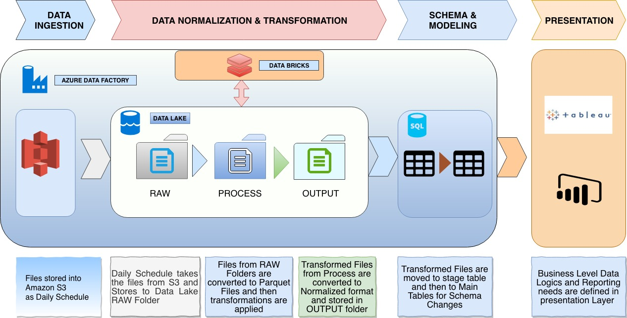

Slide 13
Data Quality Automation

Slide 14
What are the challenges in data quality on Azure Big Data systems..
Data Quality
Vision
Data volume and velocity is at a high pace and non-relational too..
Manual validation and QC is beyond the scope ..
Lack of traditional policy checks like PKs, FKs, etc.
Putting together ACID rules is hard
Data counts needs to be continuously checked..
Need to know the freshness of billions of data..
Need to ensure data coverage of transition of millions records across storage layers
Data moves between relational and non-relational stores and ensuring consistency
1
Develop a generic data quality engine that can run on Azure and capable of verifying data against multiple data sources including Azure DBs, Azure Data Lake, Warehouses and MDX Cubes
2
3
4
Distributed business rules..
Data is processed at multiple stages and faults can occur anywhere..
Goals
Support multiple connectors
Fully automated testing
Dynamic scalability
Centralized Governance
Team & Reports friendly
5
Lack of Visual Studio validation tools
No ready available tools like Performance tester etc.
6

Slide 15
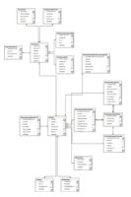
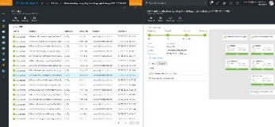
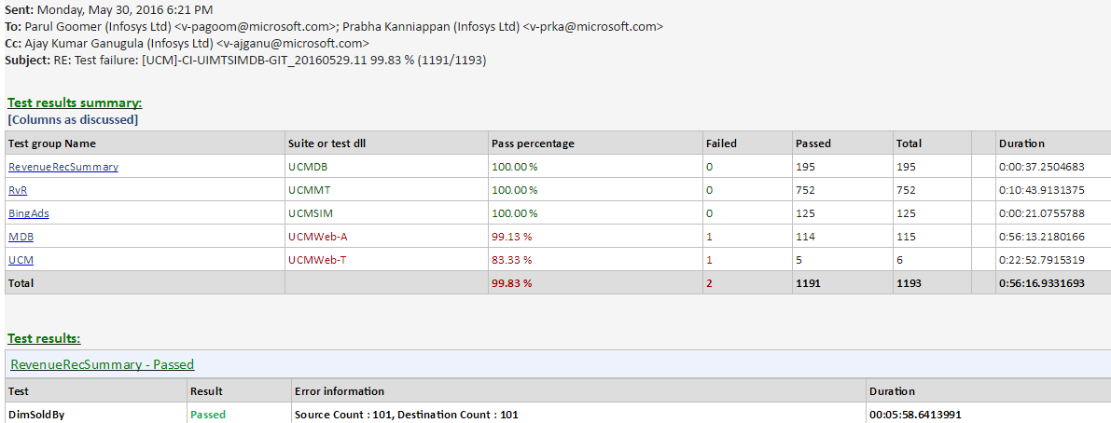
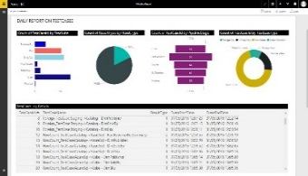
Data flow diagram of the Data Quality engine
Data Quality
Data Quality
Authoring
Execution
Data Quality Engine enabled to validate 18 rules likes value checks, primary key checks, row count checks etc.
Comprehensive work flow for authoring, execution and monitoring for Azure Data warehouse and Azure Data Lake
ATC (Automated Test Controller) with daily mails to all the stake holders
Live Power BI dashboards for analyzing the quality of the system
Test Case Authoring Engine
Test Case Scheduling
Test Case Flags
PowerShell Engine
Execute on
ADL
ADW
DB
Files
Alerting
Monitoring
Emails with Logs
Action on Bugs
Missing test cases
Live Visualization
View Logs
View Exceptions

Slide 16
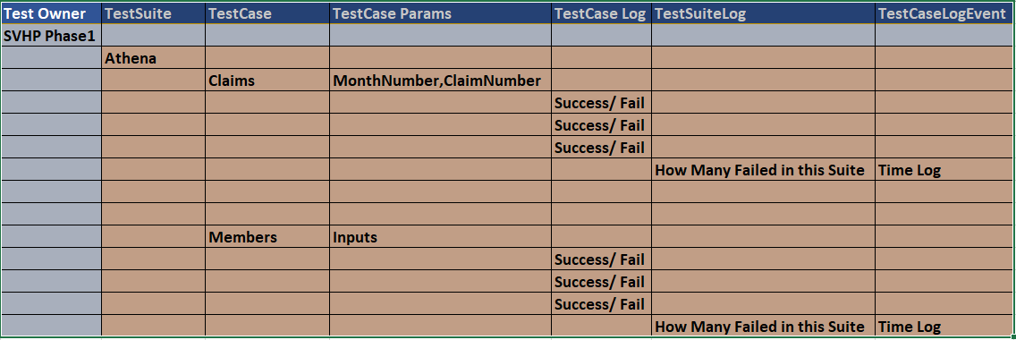
Phase 2 - Validation Storage
Notes:
Will Require SVHP Support for Test Cases on what basis they do .

Slide 17
Data Quality
What are the rules validated in UCM-B
SOURCES/
PRODUCERS
STAGING
ADLS
CLEANSING
/ENRICHMENT
TRANSFORMATION
ADLA / USQL
RDBMS
ADW
CACHED
VIEWS
PIVOTS
Cube
PRESENTATION/
ACTIONS
Data availability
Count Check
PrimaryKey Check
BoB & Quota Checks
Data Length Check
Data archiving
Foreign Key Check
Attainment Checks
Client Unit
Segment
New Business
Channel Partner
Missing Quota
Data Type Check
Dev/Prod Checks
Other Cube Check:
ARC
RvR
KPI Billing
Duplicate Row Check
All the rules above are automated using a custom PowerShell engine
17

Slide 18
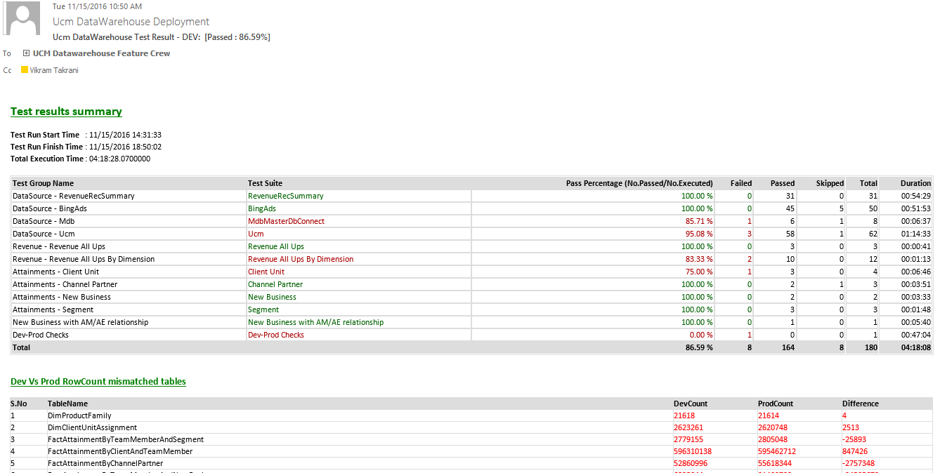
Daily Validation status in email
Program Highlights

Slide 19
NFR view in UCM-B
SOURCES/
PRODUCERS
COLLECTION / STAGING
MERGE/CLEANSING
/ENRICHMENT
TRANSFORMATION
BUSINESS RULES
CACHED VIEWS
PIVOTS
PRESENTATION/
ACTIONS
Azure Data Factory
[ Data Ingestion, Layers Orchestration and Data Auditing]
Staging Area Subscriber
[Accounts, Customer, Exchange rates, etc.]
Fast ETL
Adhoc Engines
Azure Data Lake
ADW
MDX CUBE
KPIs, Metrics Hierarchy
ADLS STAGING
HOT
Business
Users
Confirmed Dimensions
Date, Product, etc.
Optimized for 2 year
SQL Sources
PAAS/On-Prem
[MDB, UCM, etc.]
SQL Server Gateway
USQL
ADLS STAGING
Dimensions
Customer, Account, ..
Delta Merges
WARM/COLD
Analysis Services
RvR Cube
PowerShell Upload
Facts
Revenue, Attainments,
Relational DW
Business Reporting Views
UCM-B Business Reporting Web site
ADLS as TSV
[Archived daily]
Maps
Account-CU, Timeline
Cached Data
Account Teams
Structured Files
[KPIBillingCube]
WWIC Views
COLD
USQL
HYBRID PROCESSING
HYBRID STORAGE [BLOB/DB]
NORMALIZE
METRICS ENGINE
REPORTING and UIX
AZURE CAPABILITIES
ENCRYPTION
SECURITY
DATA QUALITY
TELEMETRY
LOGGING
ERROR HANDLING
WORK FLOWS
GOVERNANCE
META-DATA
LINEAGE
AUDITS
REPORTS
ALERTS
ROLES
RULES

Slide 20

What is the criteria in choosing a ‘high-performance’ data platform for UCM-B
Design & Engineering
 | Azure DW | Azure Data Lake | COSMOS
 | SQL Azure DWH – PAAS solution with elastic scale for performance/scalability Central DWH contains granular data | Azure Data Lake store/analytics aligning to Cortana Analytics Suite | COSMOS Data store for processing/storing data
Volume | Traditional central EDW is known to work for the projected volume but may not be optimal with data size of 1-2 TB | Physically partitioned data and hence can accommodate higher volumes. | Designed for high volume data warehouses.
Load Performance | Load performance can be matched with increased DTUs but comes with cost | Parallel processing with MPP results in better performance and performance can be boosted with increased DTUs | Parallel processing with Map-Reduce results in better performance.
Data Access | Access is easier. Query performance can be an issue. | Easier and data access through USQL other standard open source. | Data access restricted through Scope scripts
Scalability | 4-5 TB SQL Azure node has to be partitioned to multiple DBs | Can be scalable by adding more logical partitions for new data source/growth | Good Scalability
Strategic Alignment | Aligns with Cortana Analytics suite recommendation | Aligns with Cortana Analytics suite recommendation and strategy to migrated from COSMOS to ADL | With latest development with strategy to move to Azure Data Lake
Complexity | Simplest of the 3 approaches | Development and Complexity higher for configurable calculation engine | Development and Complexity higher for configurable calculation engine
Cost | Cost assuming a 4-5 TB size will be around $7000/TB | Medium considering Azure Data Lake instance and worker role process | Medium - High
Security Compliance | Storing PII/HBI data through encryption/ decryption modules | ADL support storing PII/HBI data at rest through OOB functionality | PI information in a common environment will not comply and has to do custom coding
Good Fit
Workaround Needed
Not Good Fit

Slide 21

Data Ingestion and Orchestration needs…
We had the challenge to find a right solution that can
Ingest millions of records per day
Orchestrate with On-Premise sources like SQL Servers and Cosmos, as well as cloud sources like SQL Azure databases
Have inbuilt capability to process data ‘as-is’ including files, databases, services etc.
We have chosen Azure Data Factories for ingestion and orchestration..

